Slide 1
Key Stage 1 Standard Assessment Tests
Parent and Carer Meeting
February 2018
Civitas Academy

Slide 2
What are SATs?
•At the end of Key Stage 1 all children are required
to be tested in different areas of Maths and English.
•Throughout the year teachers will be preparing children for these tests.
•Tests inform Teacher Assessments that are submitted to the government at the end of the year.
*The tests are just one part of a range of assessments which have been carried out throughout your child’s time in KS1.

Slide 3
When and how do the SATs take place?
The school is required to administer SATs throughout May, and all schools in England will be carrying out SATs at this time.
If children are absent, they will have to do the test on return to school.
We aim to make the SATs as non threatening as possible, therefore they will take place in KS1 classrooms, with either your child’s class teacher or another known adult organising the test or task.

Slide 4
The Tests
At the end of Year 2, children will take assessments in:
Reading
English grammar, punctuation and spelling;
Maths
*There is no test for English Writing

Slide 5
The Reading Test consists of two separate papers:
Paper 1 – Contains a variety of texts with questions.
Paper 2 – Contains a separate reading booklet. Children will write their answers to questions about the passage in a separate booklet.
Children are given time to complete as much of the paper as possible (no constraints & breaks)
The texts will cover a range of poetry, fiction and non-fiction.
Questions are designed to assess the comprehension and understanding of a child’s reading.
Stem Questions – see example question on following pages

Slide 6
Sample Questions

Slide 7
Spelling, Punctuation and Grammar
The test consists of two separate papers:
Paper 1: spelling (20 marks).
Paper 2: questions (20 marks).

Slide 8
Sample Question

Slide 9
Sample Question
Grammar, Punctuation and Vocabulary Paper

Slide 10
Sample Question
Grammar, Punctuation and Vocabulary Paper

Slide 11
Terminology
Verbs
Adjectives
Nouns
Statement sentence
Exclamation sentence
Command
Question
Do you know the meanings?
Your children should be able to explain to you.

Slide 12
Mathematics
Children will sit two tests:
Paper 1 is for arithmetic. It covers calculation methods for all operations.
Paper 2 covers problem solving, reasoning and mathematical fluency. (apparatus cannot be used ie 100 squares etc)

Slide 13
Mathematics – Sample Questions
Maths Paper 1: Arithmetic

Slide 14
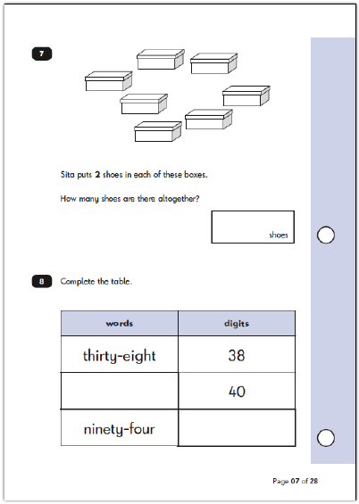
Mathematics – Sample Questions
Maths Paper 2: Reasoning

Slide 15
How to help your child
First and foremost, support and reassure your child that there is nothing to worry about and that they should always just try their best. Praise and encourage!
Ensure your child has the best possible attendance at school.
Support your child with any homework tasks.
Reading, spelling and arithmetic (e.g. times tables) are always good to practise.
Talk to your child about what they have learnt at school and what book(s) they are reading (the character, the plot, their opinion).
Make sure your child has a good sleep and a healthy breakfast every morning.

Slide 16
How to help your child with Reading
Listening to your child read can take many forms:
First and foremost, focus developing an enjoyment and love of reading.
Enjoy stories together – reading stories to your child is equally as important as listening to your child read.
Read a little at a time but often, rather than rarely but for long periods of time!
Develop stamina by using recognisable texts to improve reading speed and accuracy.

Slide 17
How to help your child with Reading
Talk about the story before, during and afterwards – discuss the plot, the characters, their feelings and actions, how it makes you feel, predict what will happen and encourage your child to have their own opinions.
Look up definitions of words together – you could use a dictionary, the Internet or an app on a phone or tablet.
All reading is valuable – it doesn’t have to be just stories. Reading can involve anything from fiction and non-fiction, poetry, newspapers, magazines, football programmes, TV guides.
Visit the local library - it’s free!

Slide 18
How to help your child with Writing
Practise and learn the tricky word lists – make it fun!
You could use spelling books to practice spelling patterns.
Encourage opportunities for writing, such as letters to family or friends, shopping lists, notes or reminders, stories or poems.
Write together – be a good role model for writing.
Encourage use of a dictionary to check spelling.
Allow your child to use a computer for word processing, which will allow for editing and correcting of errors without lots of crossing out.
Remember that good readers become good writers! Identify good writing features when reading (e.g. vocabulary, sentence structure, punctuation).
Show your appreciation: praise and encourage, even for small successes!

Slide 19
How to help your child with Maths
Play times tables games.
Play mental maths games including counting in different amounts, forwards and backwards.
Encourage opportunities for telling the time.
Encourage opportunities for counting coins and money e.g. finding amounts or calculating change when shopping.
Look for numbers on street signs, car registrations and anywhere else.
Look for examples of 2D and 3D shapes around the home.
Identify, weigh or measure quantities and amounts in the kitchen or in recipes.
Play games involving numbers or logic, such as dominoes, card games, draughts or chess.

Slide 20
Teacher Assessments
The government has set interim assessment criteria.
Currently, in Reading, Writing and Maths children will be assessed as:
Working towards the expected standard
Working at the expected standard
Working at ‘greater depth’.
Every aspect of assessment must be met for a child to achieve that standard.
In Science children will either be assessed as ‘working at the expected standard’ or not.

Slide 21
Don’t Panic!
Whilst SATs are statutory, teachers will be assessing your child’s progress throughout the year.
This means that the scores that your child achieves in the SATs are just one part of the assessment process.
Your child’s final end of year results are determined by the teacher and not the tests!

Slide 22
Finally…
Children find the testing period quite tiring (and testing!). Please do not make them participate in ‘cramming’ or ‘tutoring’ sessions after school.
We will be sending home a few light homework tasks between now and the SATS, reading, maths, spelling patterns etc to help your child prepare for the tests.

Slide 23
Any Questions?
We hope this will give you an idea of what the SATs involve.
If you have any questions please do not hesitate to ask any member of staff.
Thank you for coming!

