Slide 1
Meet the teacher – Year 5
With Miss Burr, Mrs Wanan & Mrs Ravi

Slide 2
What we’re going to discuss:
Classroom Tour
Curriculum Overview and Home Learning
Year 5 timetable
PE day and Library day
Home work
Question and answer
A copy of this presentation will be uploaded to our class webpages.

Slide 3
Classroom Tour
Recognition boards
Working walks
Trusted adults

Slide 4
Curriculum Overview

Slide 5
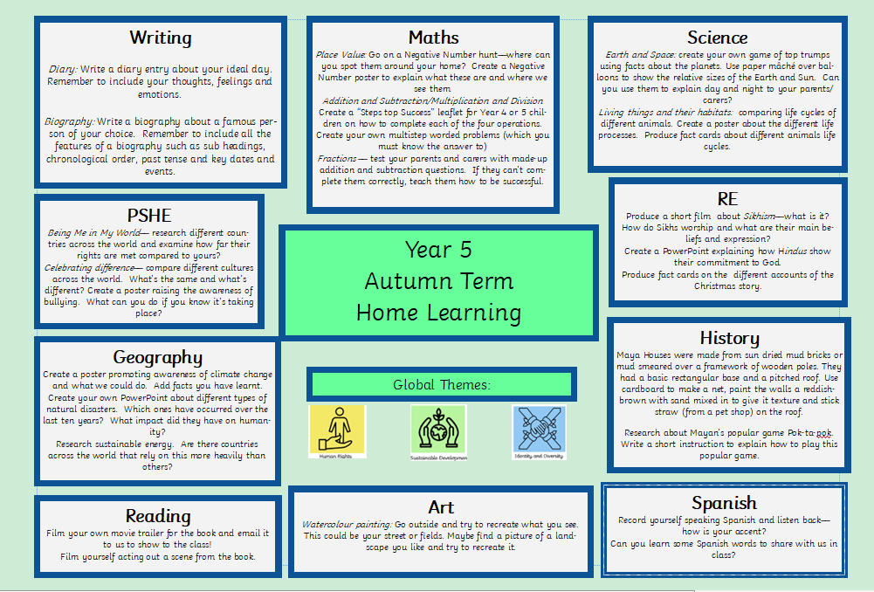
Home learning

Slide 6
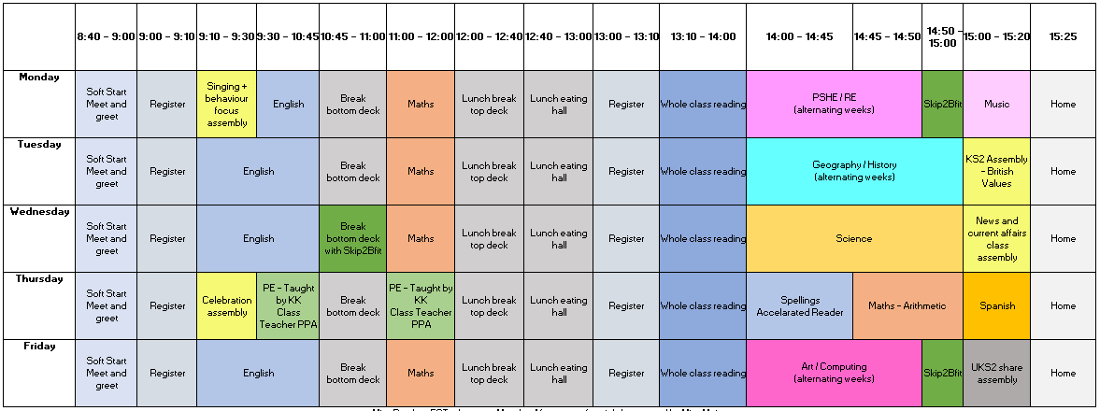
A Day in Year 5 – Daily Timetable

Slide 7
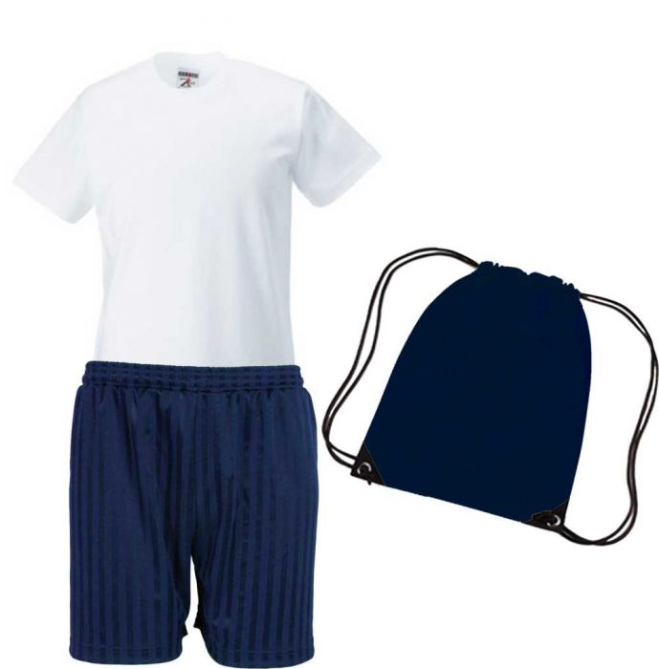
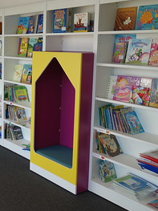
Our PE day and library day
Library – FRIDAY
We visit the KS2 library on the top floor on a Friday.
Children will be able to borrow books from the library and change them on this day.
PE day – THURSDAY
Please can children come in wearing PE kit on a Thursday.

Slide 8
Homework Expectations Homework will be sent home with children in their homework books on a Thursday. It will be due in the following Wednesday.
My Maths
From time-to-time Maths homework will be set on My Maths.
Each child has a personal login, if you need your child’s login, please email us at year5@civitasacademy.co.uk
The link for My Maths is:
https://www.mymaths.co.uk/
Spellings
We will be putting the termly spellings onto the class webpage and sending the weekly spellings in the children’s homework books.
These spellings can be practised at home and throughout the week at school.
There will be an informal spelling test on a Thursday which will be recorded in the back of your child’s homework book.
Home Learning
There is also a grid on our website with a range of ideas for learning at home about our current topic.

Slide 9
Thank you for listening! Any Questions?

