Slide 1
MyMaths
Civitas Academy
This zoom is being recorded.
Please mute yourself.
You can ask questions at the end.

Slide 2
What is MyMaths?
Online homework system used in Key Stage 1 and2
Covers the new curriculum from Year 1 to Year 6
Each homework has a tutorial that can be used
Booster packs available for each year group
Offers the opportunity to complete extra homework tasks
Builds an individual profile of strengths and development points

Slide 3
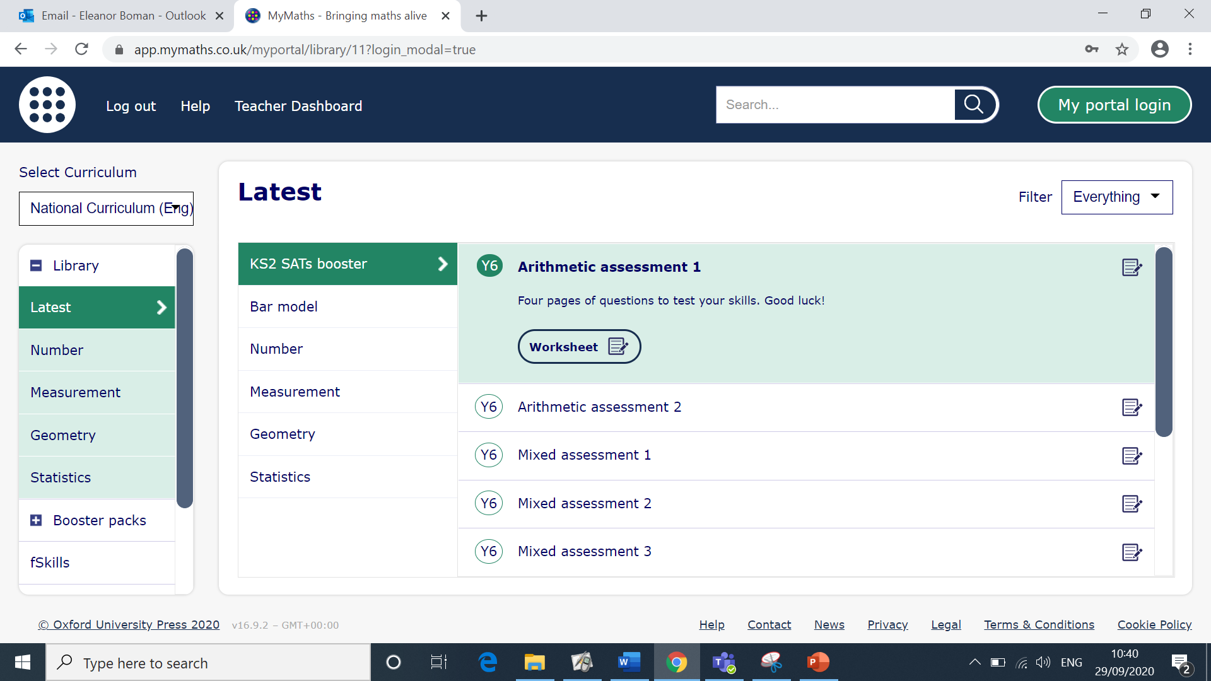
Logging on
www.mymaths.co.uk or access via the school website
On the home screen, enter the school username and password
Username: civitas
Password: tangent2

Slide 4
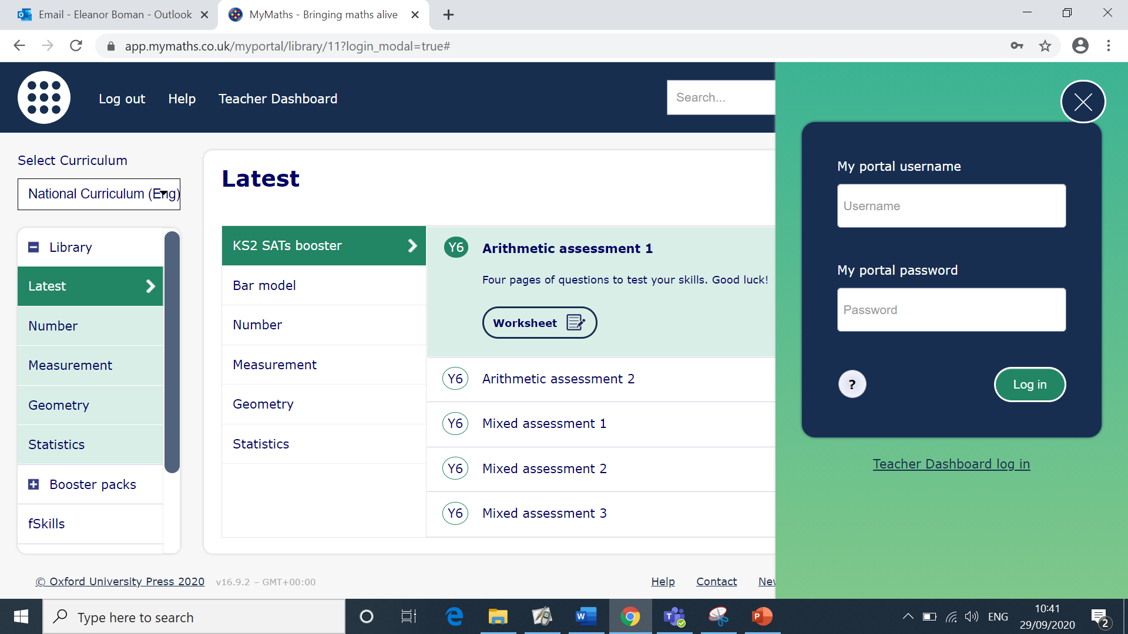
My portal
Once logged in to the school site your child will need to enter their own unique username and password into the ‘My portal’ section.

Slide 5
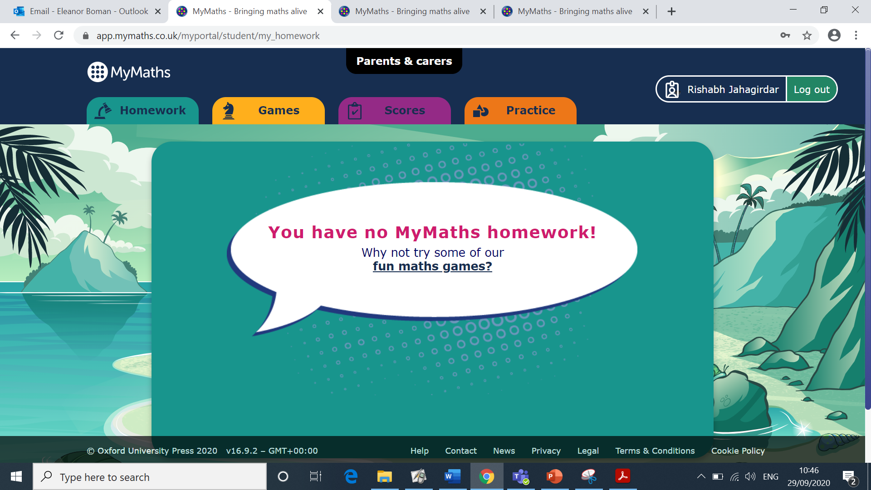
My portal
Set homework will appear on the screen as your child logs on. Overdue homework will also be listed.
Games can be accessed via the games tab. The practice tab will also open the links to extra homework and booster packs.

Slide 6
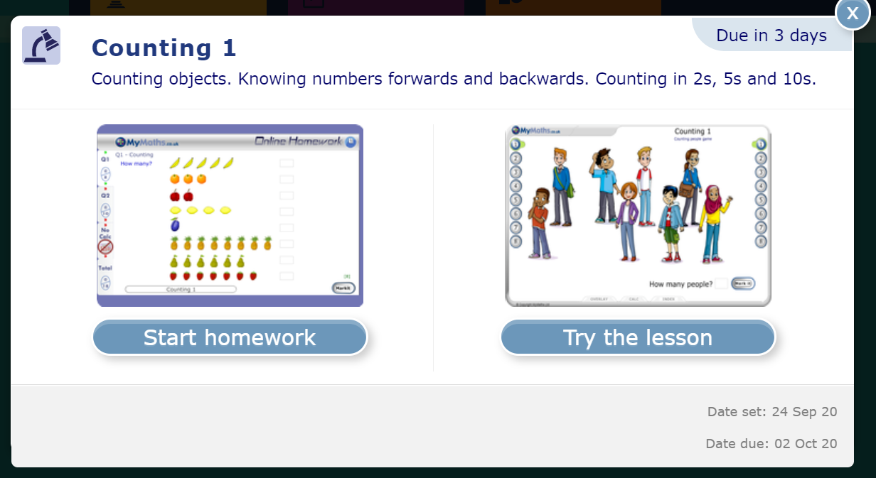
Completing homework
It is suggested that the ‘Try the lesson’ option is selected before completing the homework. This will help your child revise the topic and prepare for the type of questions asked in the homework task.
Once your child is ready, the ‘Start homework’ should be selected. The homework can be completed again and different numbers will be used.

Slide 7
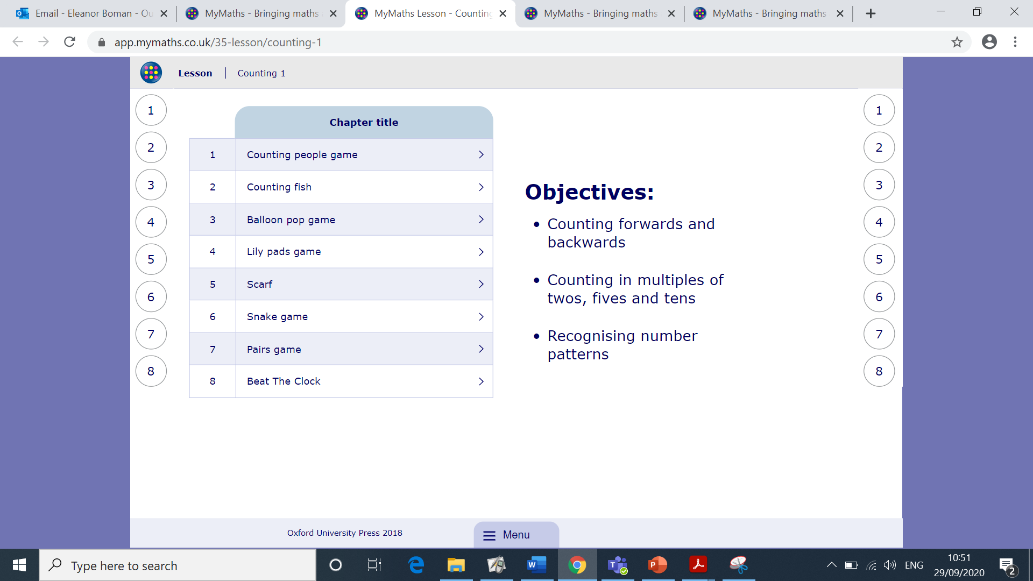
Navigating the tutorial
The numbers refer to the section of the tutorial.
Each section usually has several pages. Use the next button to move through progressively.
The index provides an overview of all pages.

Slide 8
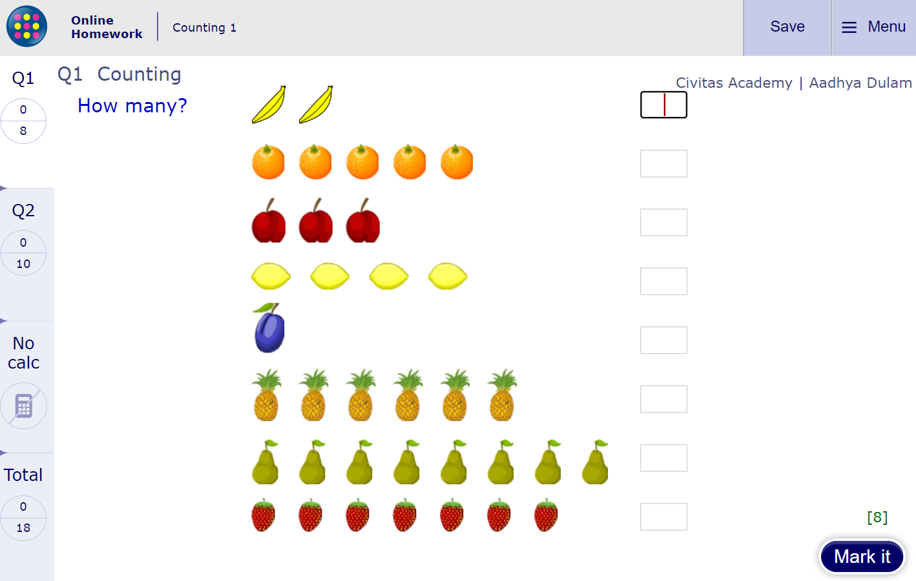
Completing the task
Homework is over two pages. Complete page 1 (Q1) first. Then select
‘Markit’ and then select Q2.
Q2 is usually harder as it often refers to an application of the topic referred to in Q1.
Once Q2 has been completed, select ‘Markit’ again. On the left hand side of the screen , the phrase ‘Check out’ appears. It is important to select this button as it will then send the results to the teacher.

Slide 9
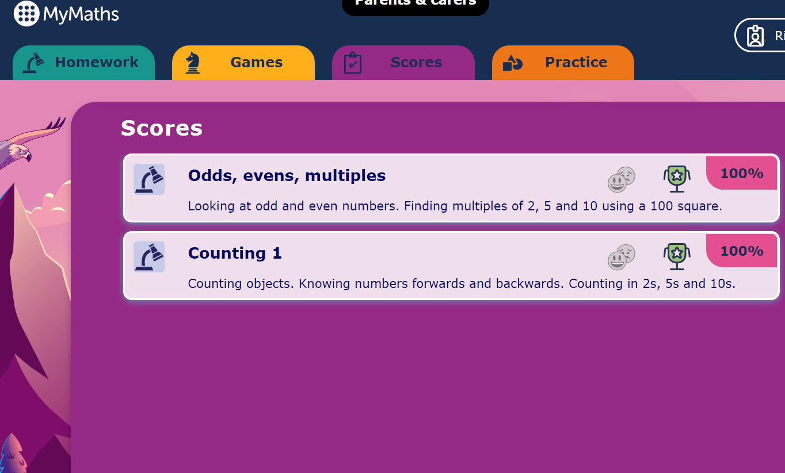
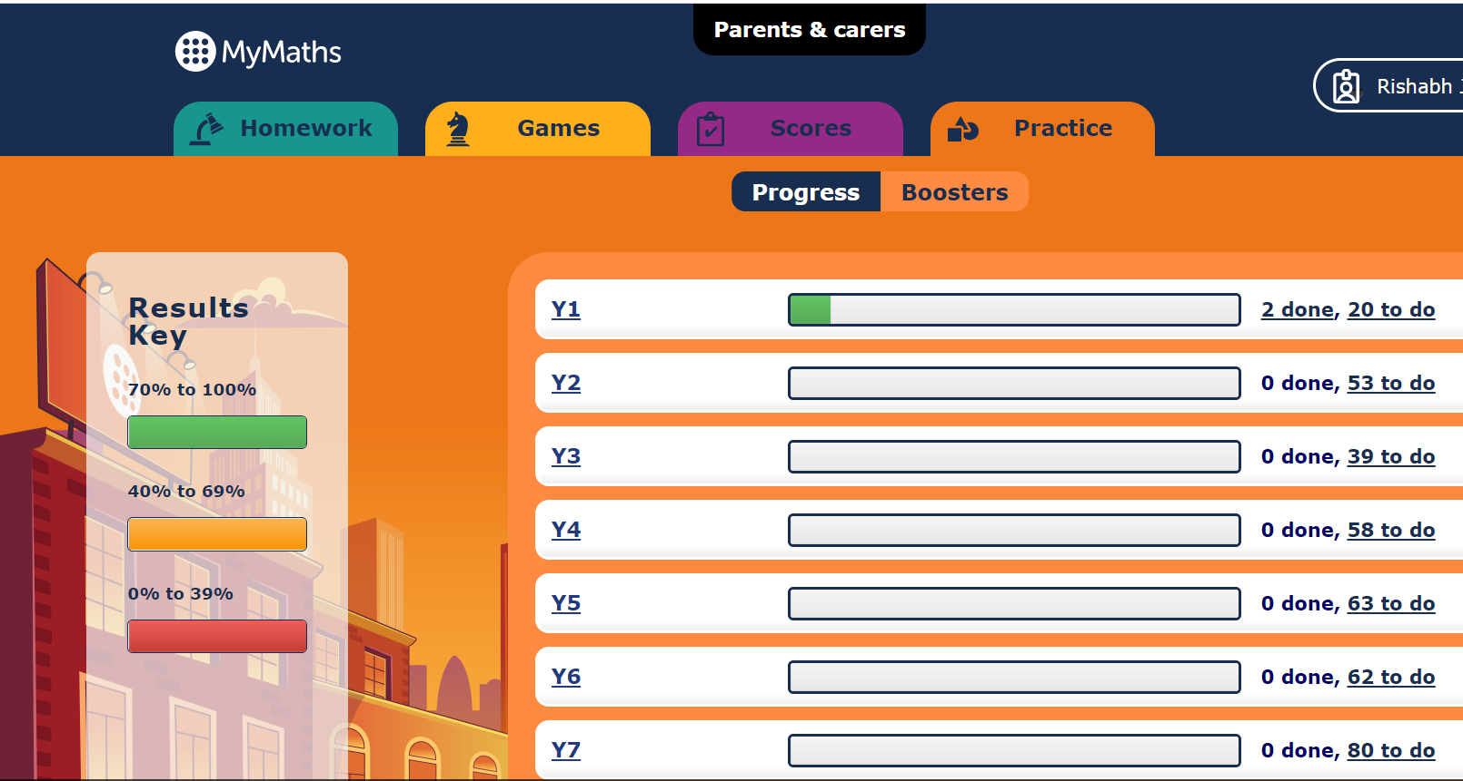
Checking Progress
On the results tab, click on ‘Progress’ and an overview of all the activities ever completed will appear.
Click on the relevant year group

Slide 10
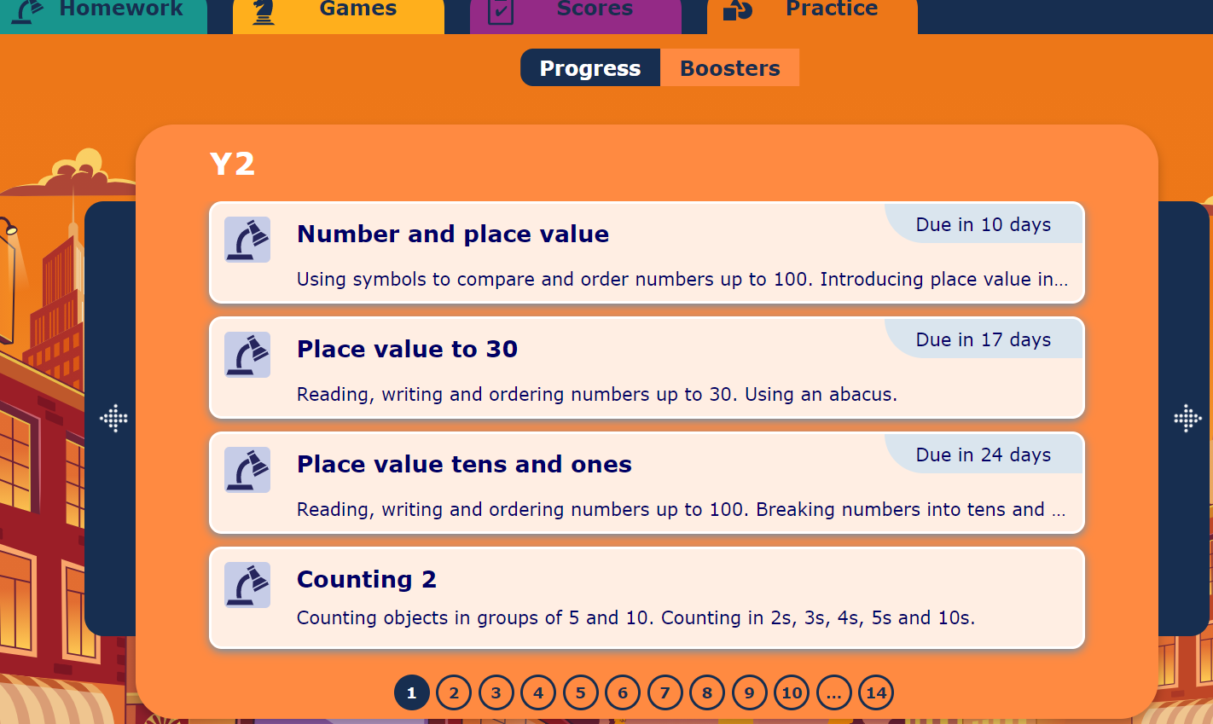
Completing additional tasks
When you click on a year group bar, the following will screen will load.
You can select to do other homework.

Slide 11
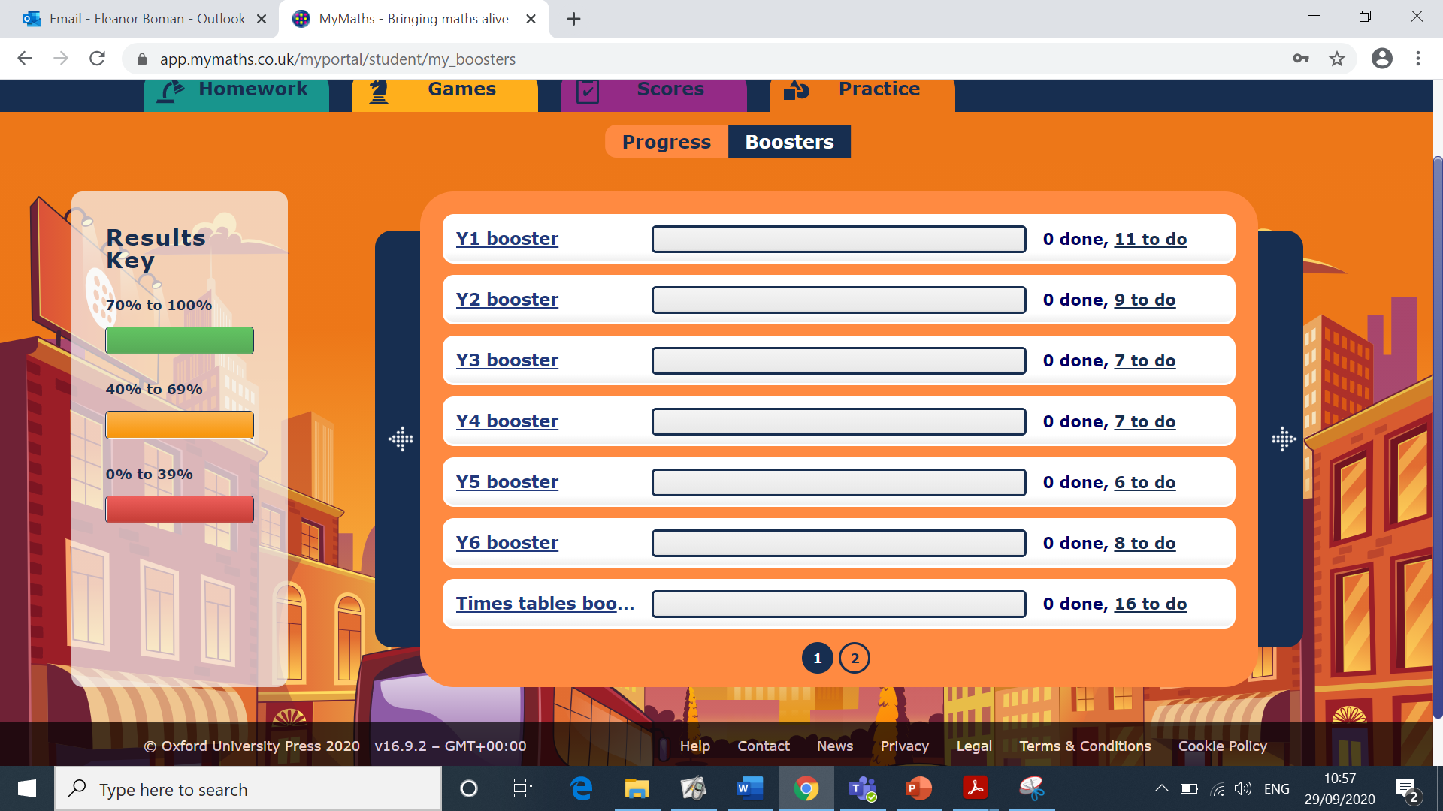
Booster Packs
Under the results tab, click on ‘Boosters’ and this will load up the activities associated with each relevant year group.
To complete activities, click on the relevant year group and again on the grey area to load up the complete list.

