Slide 1
KS2 SATS Parent Presentation
Civitas Academy

Slide 2
What are the SATs?
SATs is a term people use to refer to End of Key Stage 2 Assessments;
It lasts for four days beginning on Monday 13th May 2024 and ending on Thursday 16th May 2020;
Children will sit the following SATs papers: - Grammar, Punctuation and Spelling (Paper 1) – Monday 13th May 2024; - Grammar, Punctuation and Spelling (Paper 2) – Monday 13th May 2024; - Reading – Tuesday 14th May 2024; - Maths Paper 1 (Arithmetic) – Wednesday 15th May 2024; - Maths Paper 2 (Reasoning) – Wednesday 15th May 2024; - Maths Paper 3 (Reasoning) – Thursday 16th May 2024.
Writing is assessed using evidence collected by your child’s teacher throughout Year 6, so there is no Year 6 SATs writing test.
*The key stage 2 tests will be taken on set dates unless your child is absent, in which case they may be able to take them up to 5 school days afterwards.

Slide 3
When and how are the SATs carried out?
The tests will take place during normal school hours, under exam conditions;
Children are not allowed to talk to each other from the moment the assessments are handed out until they are collected after the test has ended;
Afterwards, the completed papers are sent away to be marked externally;
The children’s results are sent back to school at some point in July;
The standard timings of tests differ but last no more than 60 minutes: - Grammar, Punctuation and Spelling (Paper 1) – 45 minutes; - Grammar, Punctuation and Spelling (Paper 2) – 15 minutes; - Reading – 60 minutes; - Maths Paper 1 (Arithmetic) – 30 minutes; - Maths Paper 2 (Reasoning) – 40 minutes; - Maths Paper 3 (Reasoning) – 40 minutes.

Slide 4
What sort of results are reported?
Once marked, the tests will be given the following scores:
A raw score (the total number of marks achieved for each paper);
A scaled score (which is explained below);
A judgement of whether the National Standard has been met.
After marking each test, the external markers will convert each raw score into a scaled score to show whether each child is working below, at or above the national standard.
When the scaled score is given, it is given in a range from 80 to 120.
A scaled score of 100 or more is meeting the national standard.
There are no separate tests for higher achieving pupils; however, a scaled score close of 110 has been used in previous years to identify those children working at the higher standard.

Slide 5
Grammar, Punctuation and Spelling
Grammar, Punctuation and Spelling is made up of two papers which will take place on Monday 13th May 2024:
Paper 1 is the longer paper lasting 45 minutes, children will be tested on grammar, punctuation and spelling generally;
Paper 2 is a shorter paper lasting 15 minutes, where children will be tested on spelling only – they are asked to fill in a blank within a sentence, attempting to spell out the spelling word in context correctly.

Slide 6
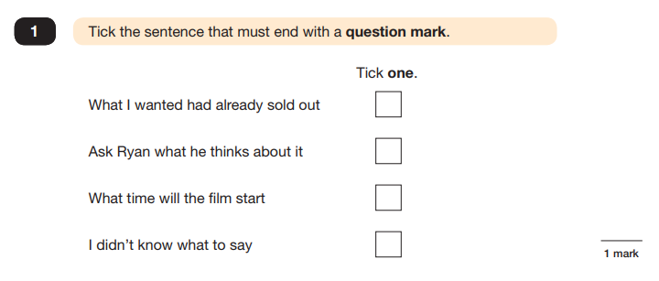
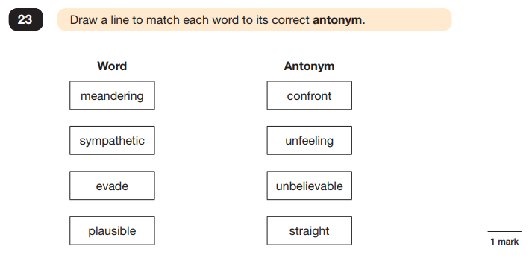
Grammar, Punctuation and Spelling (Paper 1)
Example questions:

Slide 7
Grammar, Punctuation and Spelling (Paper 2)
Grammar, Punctuation and Spelling (Paper 2) is the shorter paper lasting 15 minutes, which takes place on Monday 13th May 2024.
Example questions:

Slide 8
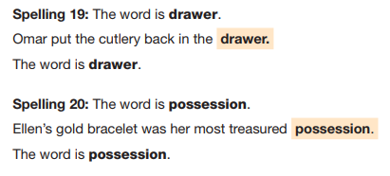
Grammar, Punctuation and Spelling (Paper 2)
Grammar, Punctuation and Spelling (Paper 2) is the shorter paper lasting 15 minutes, which takes place on Monday 13th May 2024.
Example questions:

Slide 9
Reading
The Year 6 Reading SATs paper will be sat on Tuesday 14th May 2024. The assessment has been designed to measure whether children’s comprehension of age-appropriate reading material meets the national standard.
It a standard timing of 60 minutes, including reading the texts and answering questions. There are three different set texts for the children to read, which could be any combination of non-fiction, fiction and/or poetry.
The Reading paper focuses on the following areas known as Content Domains: 2a) give/explain the meaning of words in context; 2b) retrieve and record information/identify key details from fiction and non-fiction; 2c) summarise main ideas from more than one paragraph; 2d) make inferences from the text/explain and justify inferences with evidence from the text; 2e) predict what might happen from details stated and implied; 2f) identify/explain how information/content is related and contributes to meaning as a whole; 2g) identify/explain how meaning is enhanced through choice of words and phrases; 2h) make comparisons within the text.
The Year 6 Reading SATs paper requires a range of answering styles, including responding to multiple choice questions, one-word answers, and multiple mark questions which require more formal paragraph-length answers.

Slide 10
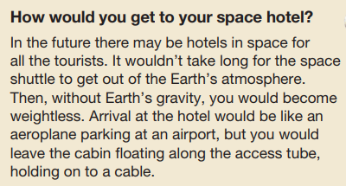
Reading
Example question, based on Text 1 – Space Tourism:
2b) retrieve and record information/identify key details from fiction and non-fiction

Slide 11
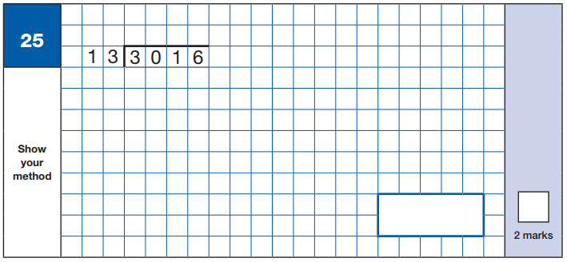
Maths Paper 1 (Arithmetic)
Maths Paper 1 (Arithmetic) will take place on Wednesday 15th May 2024.
It has a standard timing of 30 minutes and is worth a total of 40 marks.
It covers the four operations (division, multiplication, addition, subtraction and mixed operation calculations), as well as number properties, calculating percentages of amounts, calculations using decimals, and calculations using fractions.
Example question:

Slide 12
Maths Papers 2 & 3 (Reasoning)
Maths Paper 2 (Reasoning) will take place on Wednesday 15th May 2024.
Maths Paper 3 (Reasoning) is scheduled for Thursday 16th May 2024.
Both have standard timings of 40 minutes and are worth 35 marks each.
Paper 2 requires children to demonstrate their mathematical knowledge and skills, as well as their ability to solve problems and their mathematical reasoning.
Questions focus on the following Mathematical topic areas: - Number and place value– including Roman Numerals; - Addition, subtraction, multiplication and division (calculations); - Geometry – properties of shapes; - Geometry – position and direction; - Statistics; - Measurement – including length, perimeter, mass (weight), volume, time and money; - Algebra; - Ratio and proportion; - Fractions, decimals and percentages.
The questions get harder throughout the paper.
It is not unusual for a child to be unable to complete the entire paper in time.

Slide 13
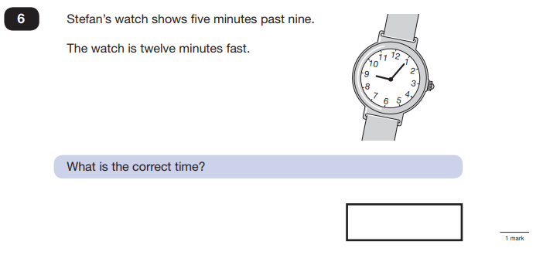
Maths Paper 2 (Reasoning)
Maths Paper 2 (Reasoning) will take place on Wednesday 15th May 2024.
Maths Paper 3 (Reasoning) is scheduled for Thursday 16th May 2024.
Both have standard timings of 40 minutes and are worth 35 marks each.
Example questions:

Slide 14
Maths Paper 2 (Reasoning)
Maths Paper 2 (Reasoning) will take place on Wednesday 13th May 2020.
Maths Paper 3 (Reasoning) is scheduled for Thursday 14th May 2020.
Both have standard timings of 40 minutes and are worth 35 marks each.
Example questions:
7 minutes to 9 or
8:53

Slide 15
How can I support my child in preparing for their SATs?
Firstly, a positive attitude goes a long way – so as much encouragement and support as possible (but we don’t need to tell you that)!
Some further tips:
• Direct any questions or concerns you have about SATs to your child’s teacher, rather than worry your child with them;
• Give your child opportunities to go outside and avoid overuse of screens - this can apply to leisure pursuits as well as how they study;
• Try to provide a quiet corner of the house for homework and study, that’s as free from distractions as possible;
• Encourage your child to talk to their teacher or another adult they trust if they express persisting anxieties about SATs. Remember that a small amount of anxiety is normal and not harmful;
• If your child is unwilling to talk to their teacher, talk to them yourself;
• Plan something nice and fun for the weekends before and after SATs – this will help your child start the week well and also give them something to look forward to;
• Ensure your child is eating and drinking well, and getting a suitable amount of sleep.

Slide 16
Remember this about SATs:
SATs focus on what they know about Maths and English
They won’t reflect how talented they are at Science, Geography, Art or PE, and they certainly won’t highlight positive personal characteristics such as kindness and integrity.
SATs results don’t always tell the whole story
The results will say they DID or DIDN’T meet a certain standard, but not necessarily by what margin. Additionally, the thresholds tend to change each year according to overall national performance, so what was classed as ‘did meet the expected standard’ in 2016 may have been considered a ‘did not’ in 2015. Therefore, don’t let your child see SATs as a simple case of ‘pass’ or ‘fail’.
SATs last for one week
In reality it’s just one or two papers lasting 30-60 minutes each day. You can’t emphasise enough the importance of keeping that in perspective.

Slide 17
Morning of SATS
Make sure you child is at school on time.
We will be providing breakfast items such as pastries and fruit.
The children will have time in the morning to complete quiet mindfulness activities before the test begin.

Slide 18
Advice for Year 6 children!
Listen to what your teacher says;
Your teacher is cheering you on and wants you to do your best;
Make sure you get plenty of sleep and stay well fed – sleep and food help keep the brain moving;
Read the questions carefully. This can help to avoid any silly mistakes!
Don’t worry if there’s something you can’t answer. Take a deep breath! You can always move on and go back later but it’s better to write something rather than nothing;
Keep in mind year 6 SATs are just one week of your entire life!

